Slide 1


Slide 2
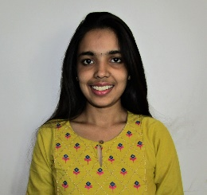
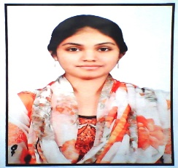
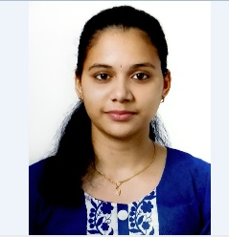
Project Highlights
Project Name : Web Page: Profile
Team Size : 3
BU Mentor Name : Mentor PS#
Team Members Details (Professional Stamp Size Photo with few lines of individual briefing
Niythya P
99002626
2009MYSSPSBI-KANAD
B. E in Computer Science
C programming, Web Technologies, Csharp, Mysql, C++
Safura Zohareen
99002474
2009MYSSPSB1-KANAD
B.E in Information Science and Engineering
C, C#, html, bootstrap, css MYSQL
Pratheeksha J
99002533
2009MYSSPSB1
B.E in Information Science and EngineeringC, C++, Java, MySQL

Slide 3
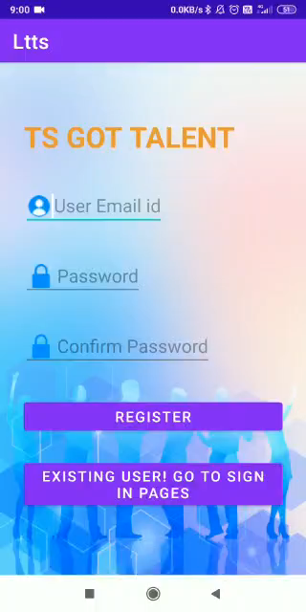

Slide 4
Future development that can be implemented further
Create a play list of all the entries under music and dance
Create an activity that accepts fresh entries for the next edition of TS Got Talent

Slide 5


Thank You !

